Slide 1
Recipe Recommendation Assignment

Slide 2
Introduction
If you visit any recipe websites, let’s say food.com, for example, you will notice a section called “You’ll also love.” Under this section, the website recommends recipes related to the one you are looking at or based on your past rating patterns.
The end objective of this entire assignment is to perform Exploratory Data Analysis and feature extraction from the raw data.

Slide 3
Problem Statement
Step into the shoes of an ML engineer working at food.com. Your job is to design a recommender system to recommend recipes to users based on their choice and the current recipe they are looking at.
The recommendation engine is a way to increase the website's user engagement. If a user is shown relevant recipes, they are more likely to spend more time on your site reading about recipes. Higher user engagement will likely result in more business opportunities like collaborations, promotions, etc.
The performance of a recommendation engine will significantly impact the revenue your recipe site can generate.
Designing a recommender from scratch is a time-consuming task. In this assignment, you are expected to explore the data and create features that will be used to build the recommender.

Slide 4
Exploratory Data Analysis for feature extraction and insights

Slide 5
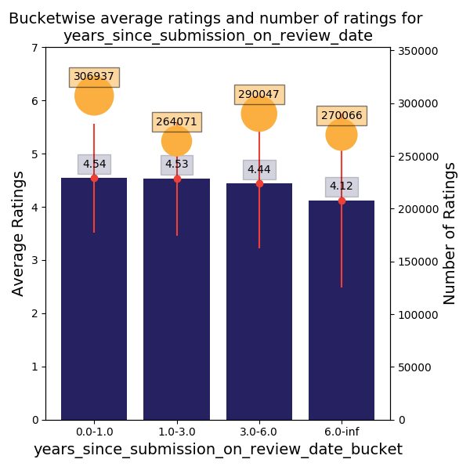
years_since_submission_on_review_date
If we look at the ‘Review Time Since Submission’,
it is apparent from the graph that recipes more than 6 years old are rated low.

Slide 6
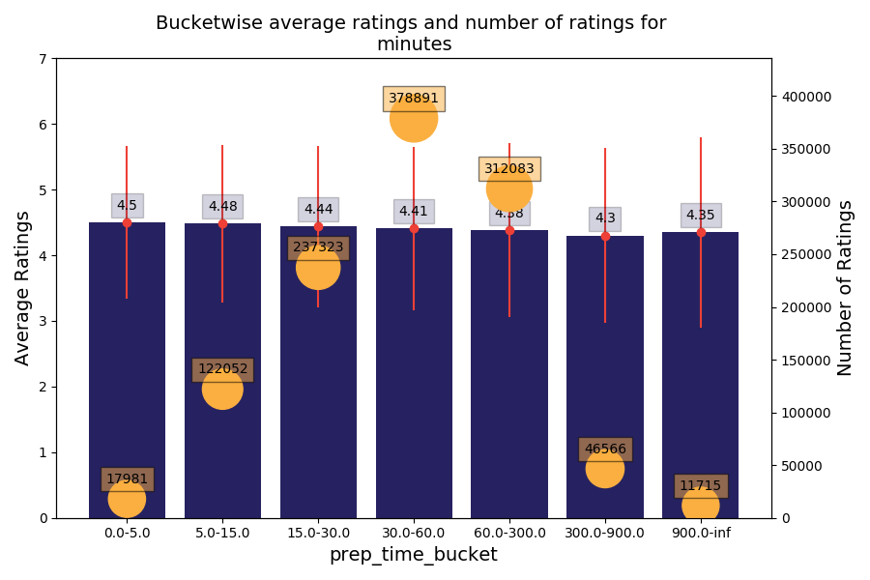
minutes
If we look at the prep time, we can notice that somewhat relevant low prep time is preferred.

Slide 7
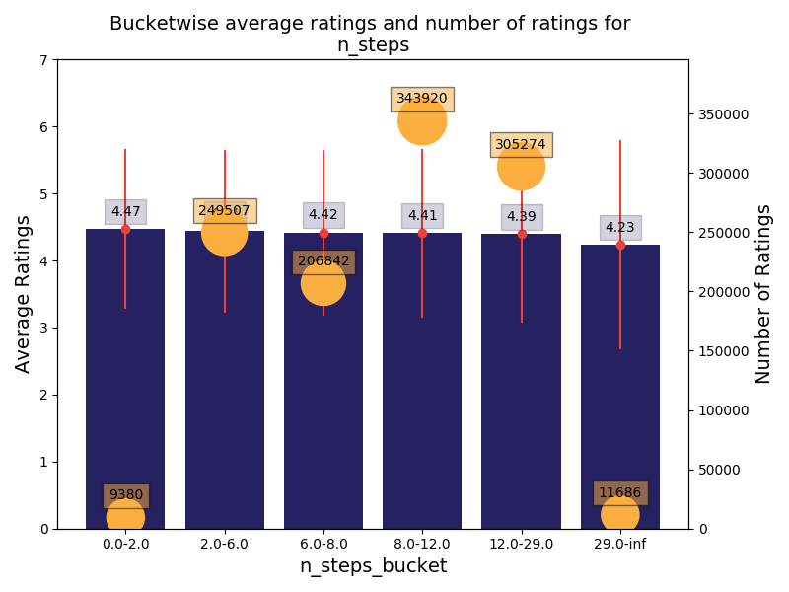
n_steps
It is clearly relevant that recipes with less than 2 steps are rated high and recipes with more than 29 steps are rated very low.

Slide 8
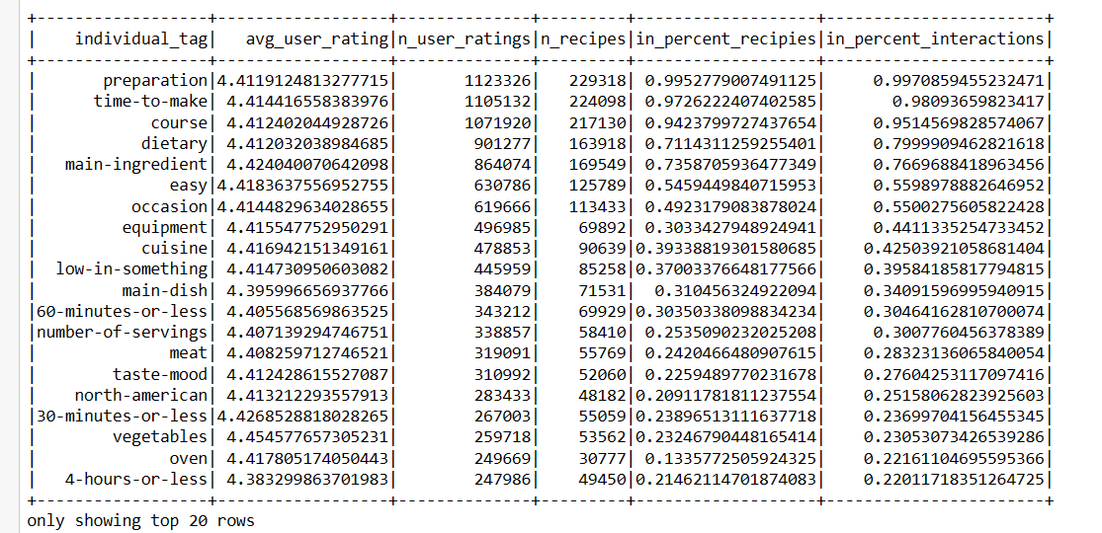
Top n most rated tags
These are the tags present in high number of recipes

Slide 9
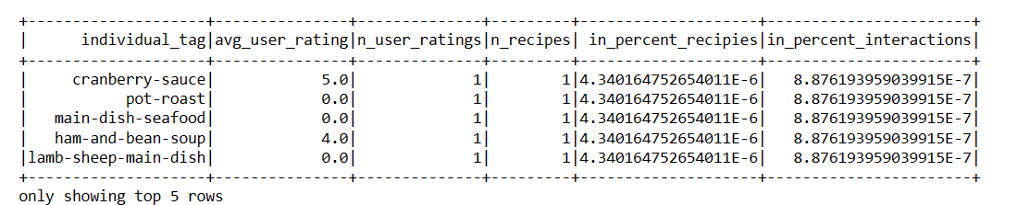
Bottom n least rated tags
The above tags are present in 1 recipe in over two hundred thousand. The features we create based on these tags will not teach the model new information. If these tags were one hot encoded, the entire column would be filled with zeros, and only a few rows will have 1s. One hot encoding of these tags is not a good idea. If you come up with an encoding that captures the rarity of these tags, only then can you add these tags to the analysis.

Slide 10
Conclusion
By performing EDA , we can see that few of the features that are relevant are years_since_submission_on_review_date, minutes of preparation and n_steps.
We also saw the top n most rated tags and bottom n least rated tags. This knowledge can further be used for business purposes.

Slide 11
Thank you

